Slide 1


Finding and Obtaining a Job
-Advice from a Recruiter

Slide 2

Agenda
Section 1: Search Strategy
Section 2: Drafting Resume
Section 3: Interview Tips
Activity Session

Slide 3

Targeted Search Strategy
It’s OK to go to job search sites like Indeed, but it should not be your strategy
You want to access the hidden job market

Slide 4

Places/Methods to find “Hidden” Jobs
Make a “Top 10” List
Check your LinkedIn Contacts
Join professional groups and associations
Good Ol’ Fashioned Networking
Notes:
Make a “Top 10” List
Make a list of companies you’d love to work for
Check these company sites regularly for postings
Check your LinkedIn Contacts
See if you know someone on the inside
Reconnect with old friends
LinkedIn job aggregator
Join professional groups and associations
Web/LinkedIn/Facebook/Twitter
Good Ol’ Fashioned Networking
Talk, talk, talk
Listen, listen, listen
Let people know your situation

Slide 5

Quality over Quantity
Don’t send out dozens of applications
Target is 3 or 4 good applications per day
In addition to application, try and get whatever edge you can

Slide 6

Drafting Your Resume
Determine your style/format

Slide 7
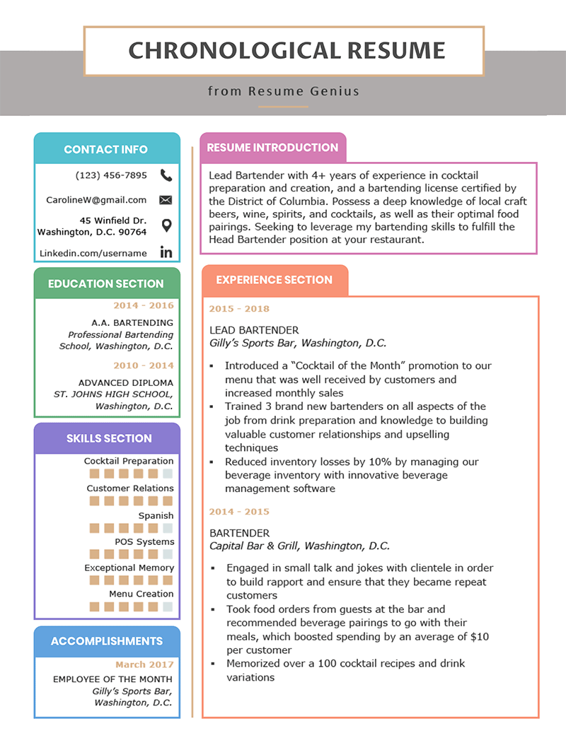
Chronological Resume
Work experience in chronological order
Focused career path
Related experience
Notes:
Lists work experience in an easily identifiable chronological order, detailing each position you have held
Ideal format if you have have a focused career path (you are looking for a specific type of job, not just any job)
You must have some experience related to the jobs you are targeting (work or volunteer)
Signals employers that you are experienced

Slide 8
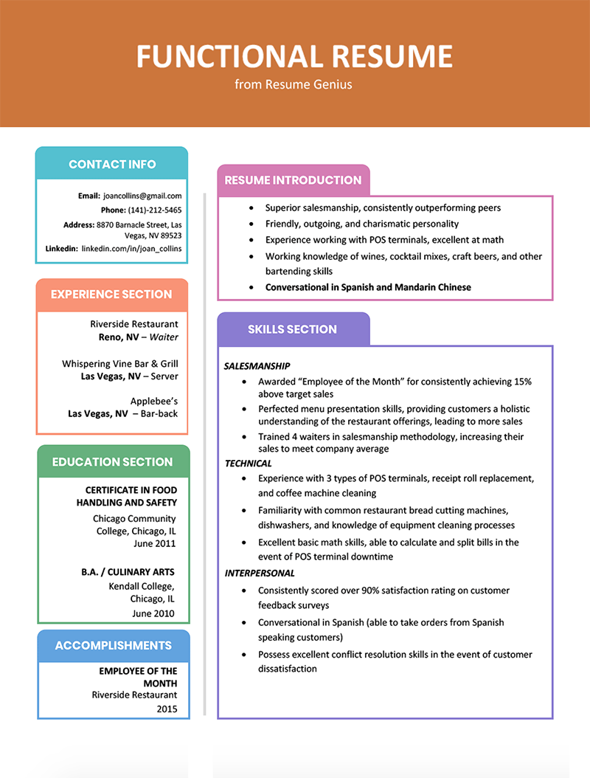
Functional Resume
Focused on skills, technical knowledge and achievements
Not focused on workplace experience
Great for someone with less experience or new grads
Notes:
Focuses on skills, technical knowledge, and achievements
Does not put the focus on workplaces or years (you still would identify them, but it would be a small part of your resume, perhaps bulleted at the end of the resume)
Consider using this if you don’t have a great deal of experience, or you’re just entering the industry out of school
Dazzle employers on the first page with impressive achievements and skills that differentiate you from the rest of applicants

Slide 9
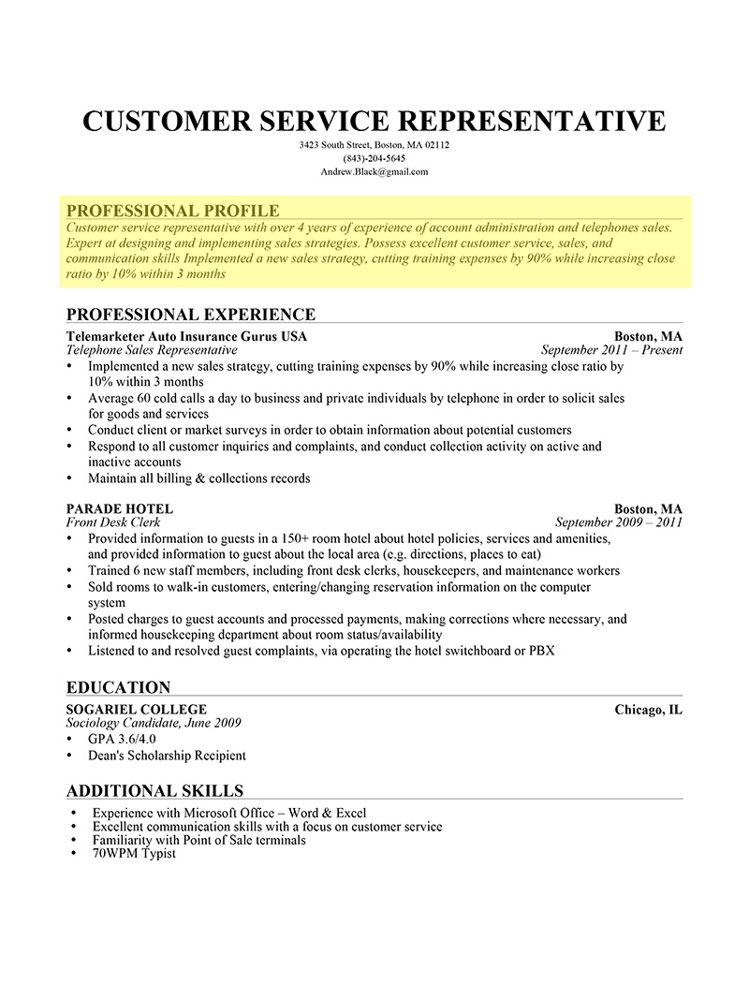
Drafting Your Resume
Don’t use objective
Focus on impressive achievements and skills
Quantitative skills and achievements
Differentiate yourself and include something unique
Section changes with job posting
Notes:
Have a stunning Professional Profile
Don’t use objective – this is extremely old-fashioned and Employers are usually not interested. Takes up valuable space on your resume
Focus on your most notable and impressive achievements and skills
Try and include quantitative, numbers – this makes your skills and achievements more real.
DIFFERENTIATE yourself from the rest. Include skills/experience that is unique and not everyone else has
Keep in mind that this section will change depending on the job posting you are applying for

Slide 10
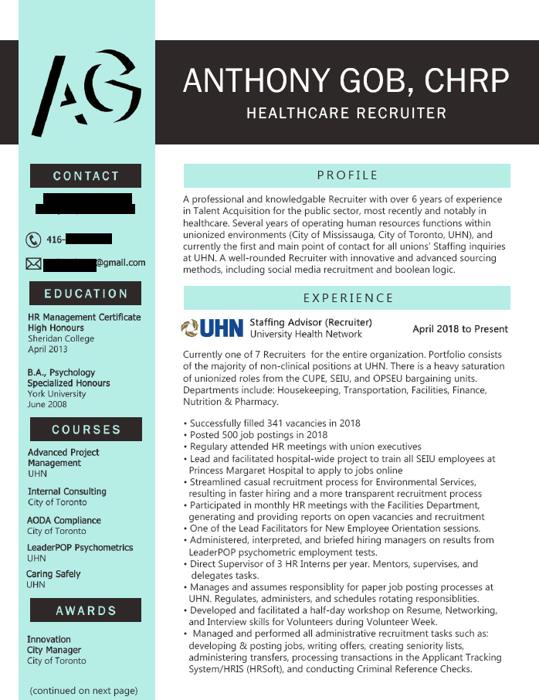
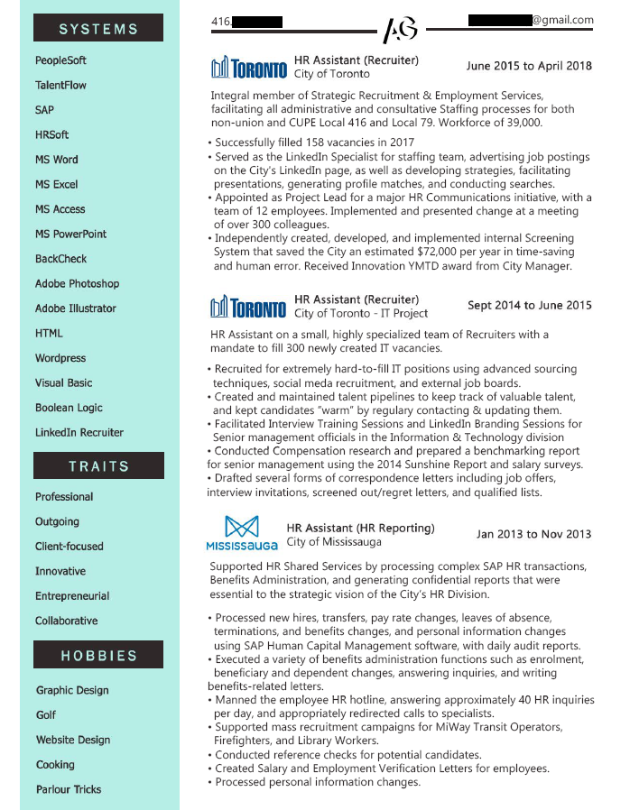
Drafting Your Resume
  Use colors and graphic design
  Use logos of the companies you have worked for
Notes:
The use of colour or graphic design enhances your resume and makes it noticeable.
For some reason, applicants are hesitant, but it really does not harm your chances at all, it only improves your chances
Consider using logos of the companies you have worked for (like on LinkedIn)

Slide 11
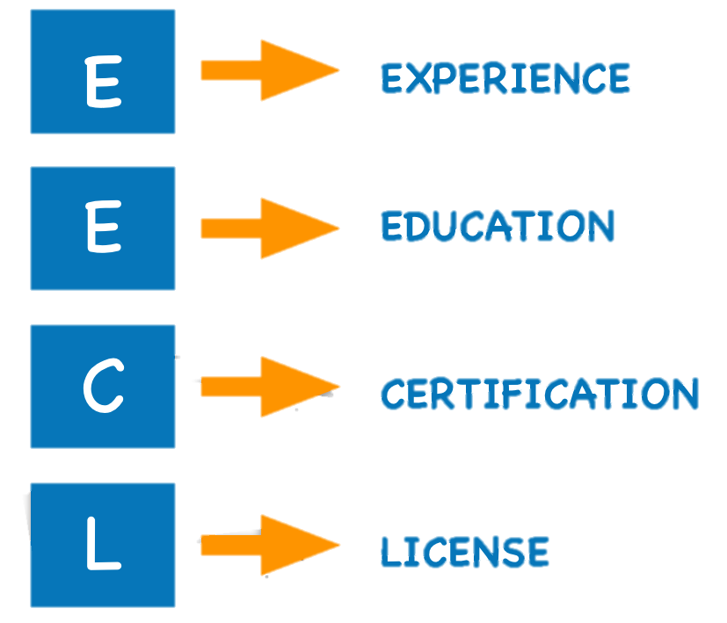
Tailor your resume to the job posting you are applying for
Look at the job posting and what the employer is looking for
Determine what they are paper-screening for
Ensure EECL is addressed in your resume, in your profile and in your experience with demonstrated experience
Notes:
Look at the job posting, get a sense of the job and what the employer is looking for
Determine what they are paper-screening for. Look for the EECL’s. (Experience, Education, Certification, License)
Make sure the EECL’s are addressed clearly in your resume, in the profile, and in your experience, with demonstrated experience (don’t just say you have experience with so-and so)
(picture of EECL, or, highlighting a resume)

Slide 12

Interview Tips

Slide 13

Interviewing
Prepare for your interview (answers to common questions)
S-T-A-R method (Situation – Task – Action – Result)
Dress for the part.
Maintain a good posture and be engaged during the interview. Be alive!
“Mimic” your interviewer (Speak at the same pace as them and watch their pencil when they are writing notes. Speak your answers at the same speed as their pencil)
Use examples where you can use the word “I” rather than “we”
Notes:
Prepare for your interview. Prepare answers to common interview questions.
Use the S-T-A-R method when formulating answers. Every answer to an interview question is usually a brief story. (Situation – Task – Action – Result)
Dress for the part. Think about what you will wear every day if you got the job, and dress a little better than that for the interview.
Maintain a good posture, and be engaged during the interview. Be alive!
“Mimic” your interviewer. Speak at the same pace as them, and watch their pencil when they are writing notes. Speak your answers at the same speed as their pencil, because you want them to write down all of your answers.
Use examples where you can use the word “I” rather than “we”. If you did good work, take credit for what you did. Tell the interviewer specifically what you did and what you achieved.

Slide 14
Interviewing Exercise
Tell me about yourself.
Tell me about a time you had multiple tasks with tight deadlines. How did you get the work done?
Tell me about a time you made a mistake or error in judgment. What was the outcome?
Tell me about a time you had a conflict with a client or co-worker. How did it get resolved?

Slide 15
Thank You
& GOOD LUCK!!!!

